Slide 1
BHARTI INFOTECH AND SERVICES
Bilaspur , Chhattisgarh
Introduction to Gear motor

Slide 2
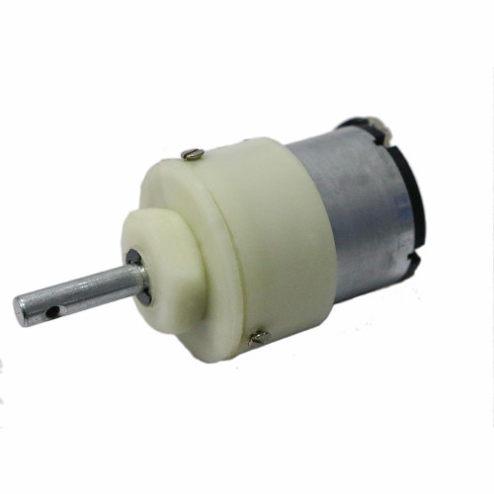
Working of Center Shaft Gear Box
The working of the gears is very interesting to know. It can be explained by the principle of conservation of angular momentum. The gear having smaller radius will cover more RPM than the one with larger radius. However, the larger gear will give more torque to the smaller gear than vice versa. The comparison of angular velocity between input gear (the one that transfers energy) to output gear gives the gear ratio. When multiple gears are connected together, conservation of energy is also followed. The direction in which the other gear rotates is always the opposite of the gear adjacent to it. In any DC motor, RPM and torque are inversely proportional. Hence the gear having more torque will provide a lesser RPM and converse.

Slide 3
A DC Geared motor is a simple DC motor with gear box attached to the shaft of the motor which is mechanically commutated electric motor powered from direct current (DC) Construction of Center Shaft Gear Box
On opening the outer plastic casing of the gear head, gear assemblies on the top as well as on bottom part of the gear head are visible.. A strong circular imprint shows the presence of the gear that rotates the gear at the upper portion. The cap that accommodates the gear has an arc cut from its side to avoid frictional resistance forces with the bottom gear assembly. The bottom houses the gear mechanism which is connected to the DC motor through screws. This mechanism rotates the gear at the top which is connected to the rotating shaft.

Slide 4
The gear assembly is set up on two metallic cylinders whose working can be called as similar to that of an axle. A total of three gears combine on these two cylinders to form the bottom gear assembly out of which two gears share the same axle while one gear comes in between them and takes a separate axle. The gears are basically in form of a small sprocket but since they are not connected by a chain, they can be termed as duplex gears in terms of a second cog arrangement coaxially over the base. Among the three gears, two are exactly same while the third one is bigger in terms of the number of teeth at the upper layer of the duplex gear. The third gear is connected to the gear at the upper portion of the gear head. After the gear assembly is removed, gear head’s connection to the DC motor and its gear can be easily seen. The machine has a smaller gear in comparison to the gear head’s gear assembly.

Slide 5
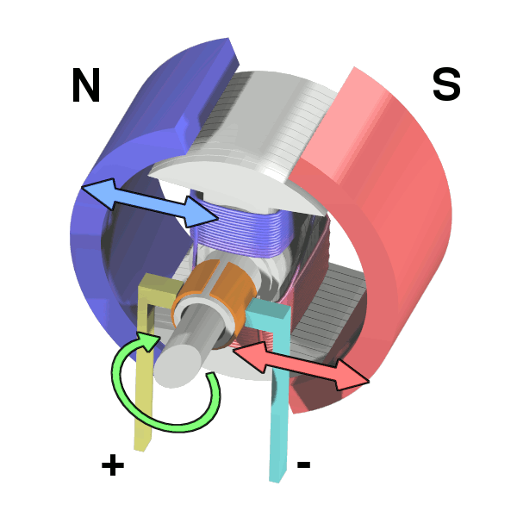
A DC motor is any of a class of rotary electrical machines that converts direct current electrical energy into mechanical energy. The most common types rely on the forces produced by magnetic fields. Nearly all types of DC motors have some internal mechanism, either electromechanical or electronic, to periodically change the direction of current flow in part of the motor.
DC motors were the first type widely used, since they could be powered from existing direct-current lighting power distribution systems. A DC motor's speed can be controlled over a wide range, using either a variable supply voltage or by changing the strength of current in its field windings. Small DC motors are used in tools, toys, and appliances. The universal motor can operate on direct current but is a lightweight motor used for portable power tools and appliances. Larger DC motors are used in propulsion of electric vehicles, elevator and hoists, or in drives for steel rolling mills. The advent of power electronics has made replacement of DC motors with AC motors possible in many applications.

Slide 6
Electromagnetic motors
A coil of wire with a current running through it generates an electromagnetic field aligned with the center of the coil. The direction and magnitude of the magnetic field produced by the coil can be changed with the direction and magnitude of the current flowing through it.
A simple DC motor has a stationary set of magnets in the stator and an armature with one or more windings of insulated wire wrapped around a soft iron core that concentrates the magnetic field. The windings usually have multiple turns around the core, and in large motors there can be several parallel current paths. The ends of the wire winding are connected to a commutator. The commutator allows each armature coil to be energized in turn and connects the rotating coils with the external power supply through brushes. (Brushless DC motors have electronics that switch the DC current to each coil on and off and have no brushes.)
The total amount of current sent to the coil, the coil's size and what it's wrapped around dictate the strength of the electromagnetic field created.
The sequence of turning a particular coil on or off dictates what direction the effective electromagnetic fields are pointed. By turning on and off coils in sequence a rotating magnetic field can be created.

Slide 7
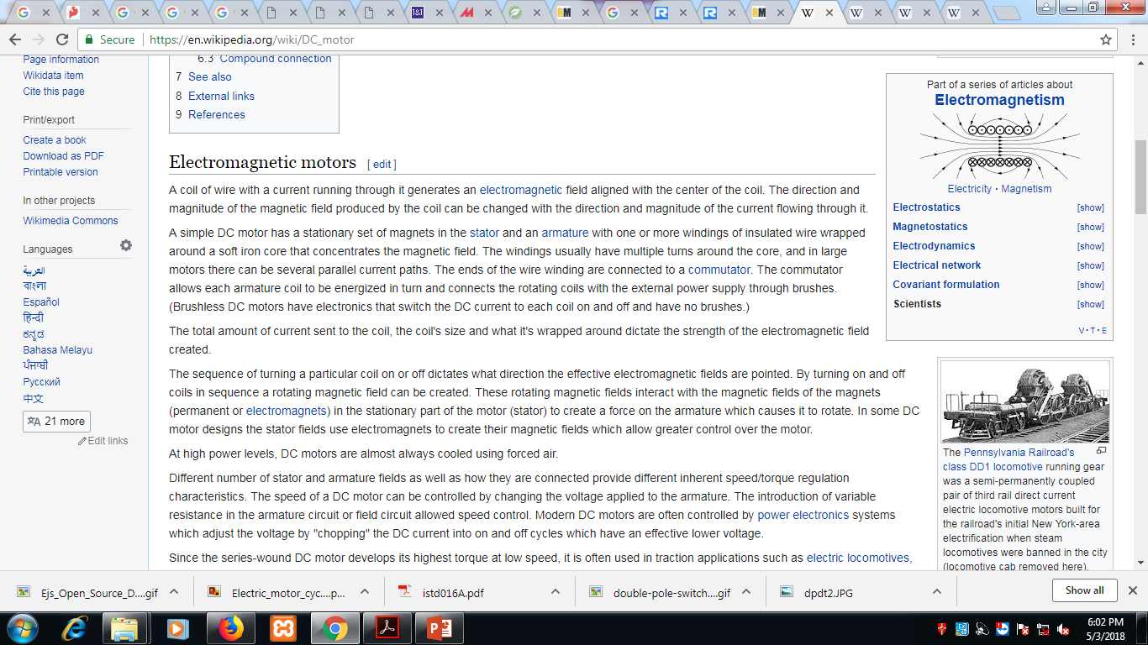
These rotating magnetic fields interact with the magnetic fields of the magnets (permanent or electromagnets) in the stationary part of the motor (stator) to create a force on the armature which causes it to rotate. In some DC motor designs the stator fields use electromagnets to create their magnetic fields which allow greater control over the motor.
At high power levels, DC motors are almost always cooled using forced air.

